Slide 1
Introduction to Packet Tracer
Course Code: CSC 3116
Course Title: Computer Networks
Dept. of Computer Science
Faculty of Science and Technology
Lecturer No: | Lab 4 | Week No: | 3 | Semester: | Summer 23-24
Lecturer: | Md. Faruk Abdullah Al Sohan; faruk.sohan@aiub.edu

Slide 2
Packet Tracer
Packet Tracer is a cross-platform visual simulation tool designed by Cisco Systems that allows users to create network topologies and imitate modern computer networks. The software allows users to simulate the configuration of Cisco routers and switches using a simulated command line interface. Packet Tracer makes use of a drag and drop user interface, allowing users to add and remove simulated network devices as they see fit.
You can download it for free . Go to https://www.netacad.com/courses/packet-tracer-
download/
At first , create an account in netacad, and download it logging into your account
so that packet tracer doesn‘t get expired.

Slide 3
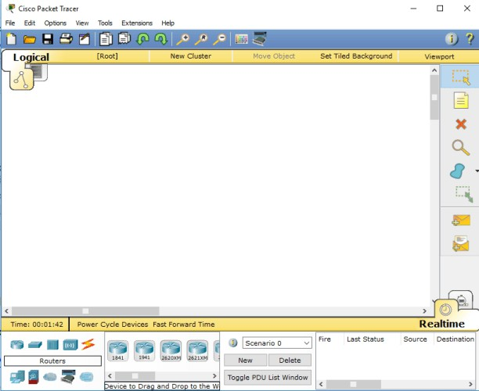
Packet Tracer
This is the first view after openning the packet tracer

Slide 4
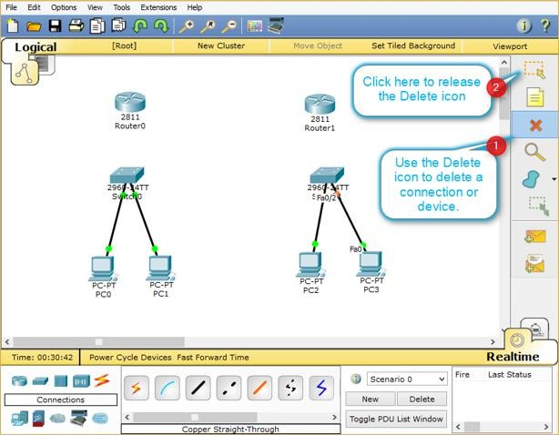
Packet Tracer

Slide 5
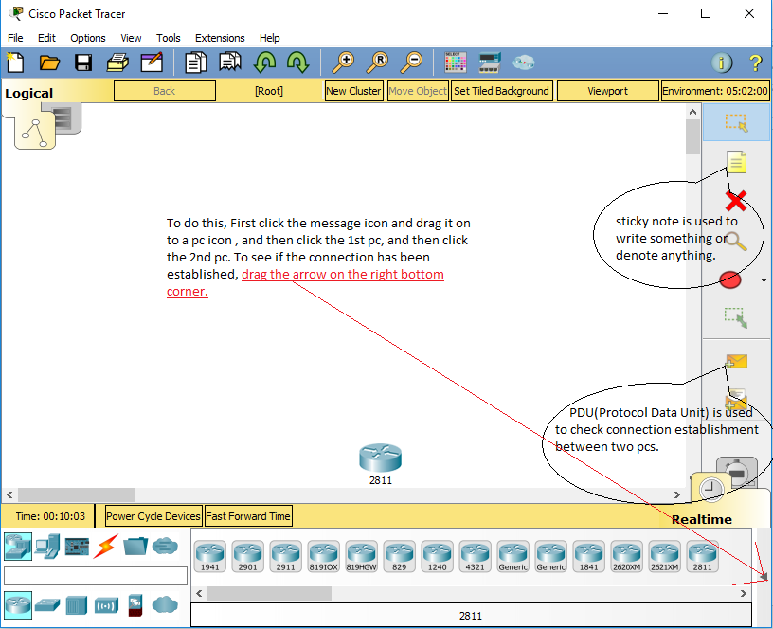
Packet Tracer

Slide 6
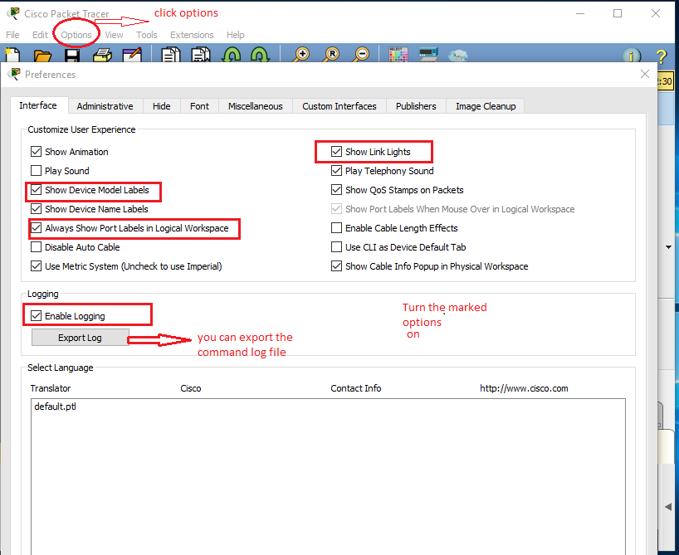
Packet Tracer
Click options and select preference

Slide 7
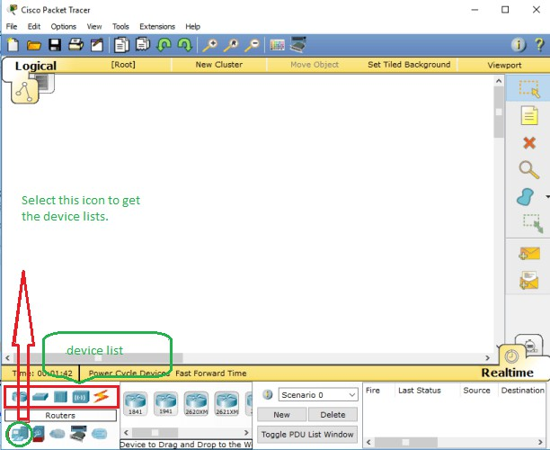
Packet Tracer

Slide 8
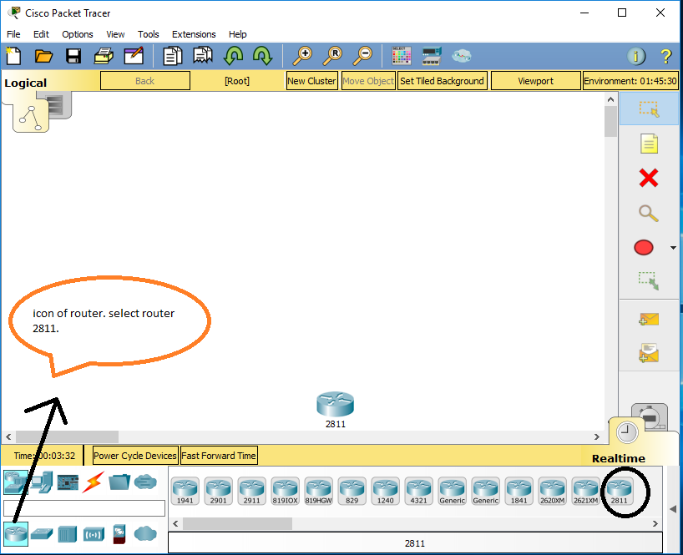
Packet Tracer

Slide 9
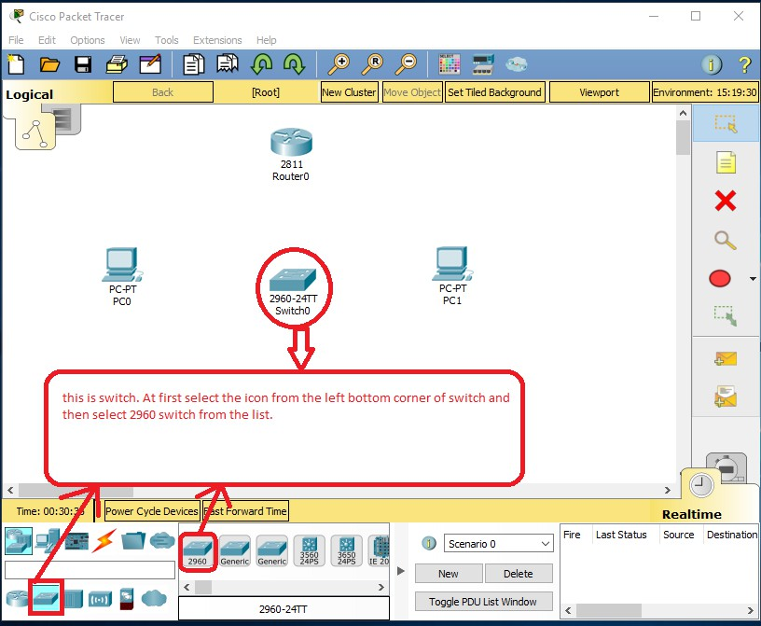
Packet Tracer

Slide 10
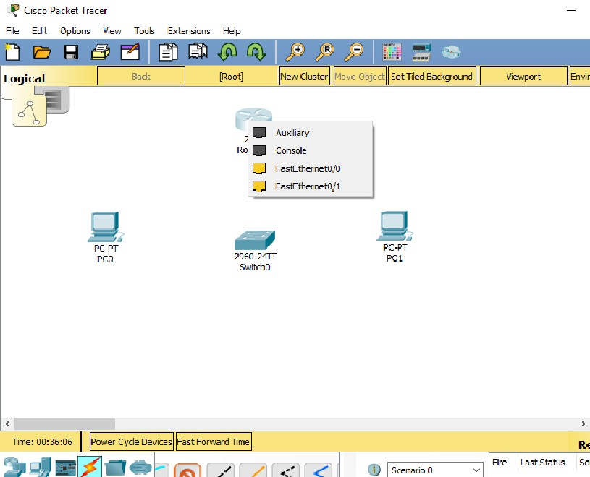
Packet Tracer
After selecting CST wire, click on to the router and you will see such connection port list.
It is better to choose first one from FastEthernet Ports.
Here FastEthernet0/0 has
been selected.

Slide 11
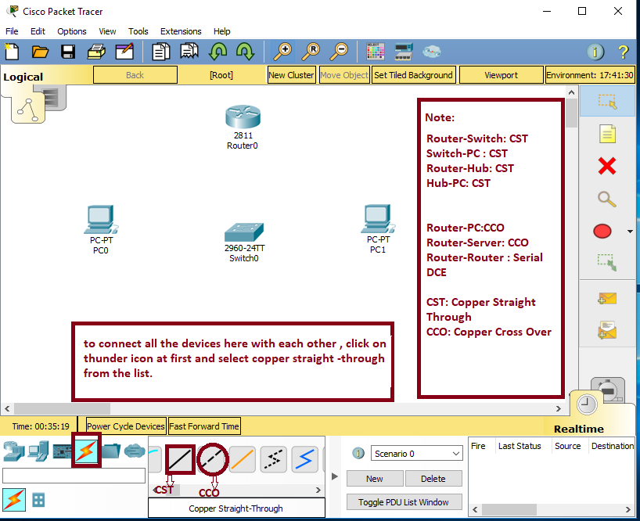
Packet Tracer

Slide 12
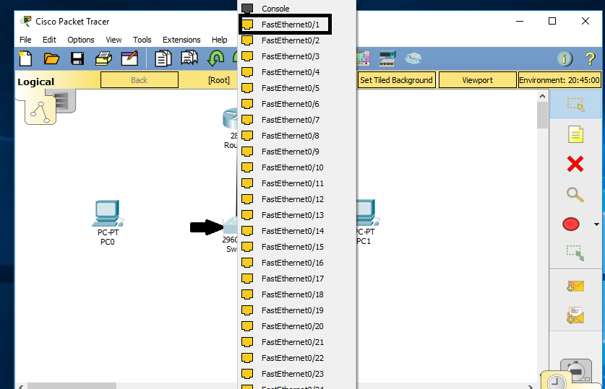
Packet Tracer
Then click on to the switch and you will see such connection port list.
Like before,It is better to choose first one from FastEthernet ports.
Here FastEthernet0/1 has
been selected.

Slide 13
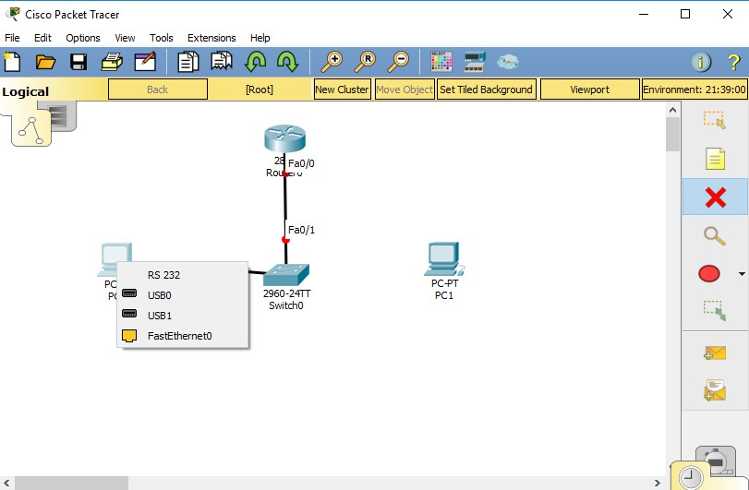
Packet Tracer
Then again click on to the switch and you will see connection port list like previous slides and select the top most one.
Then connect the switch with PC0 and choose FastEthernet0.

Slide 14
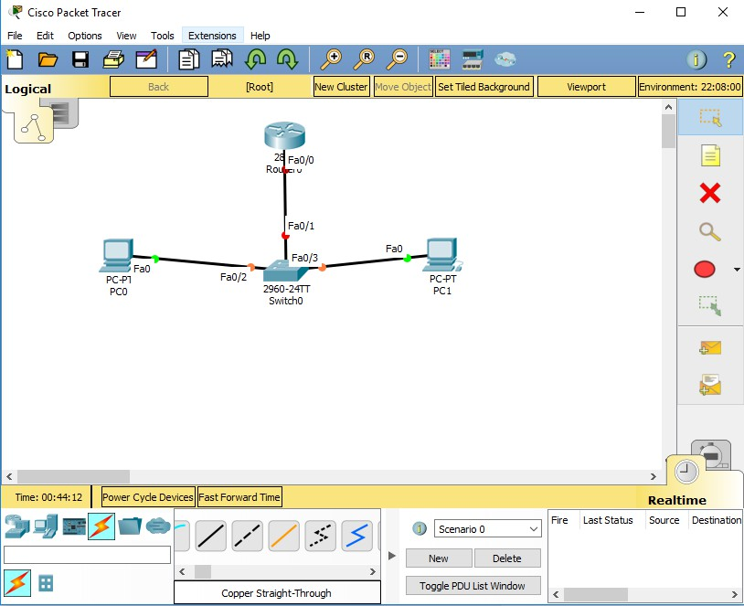
Packet Tracer
So a network topology has been created here.
A connection has gone from
Router to Switch and then Switch to PCs.
Notice that, there are some light over the connections which indicates , the connection has been established or not.
Green Light means devices successfully connected.
Red Light means , Connection
are not established.
For first time, enable Fast Forward Time to establish connections between devices in a faster way.

Slide 15
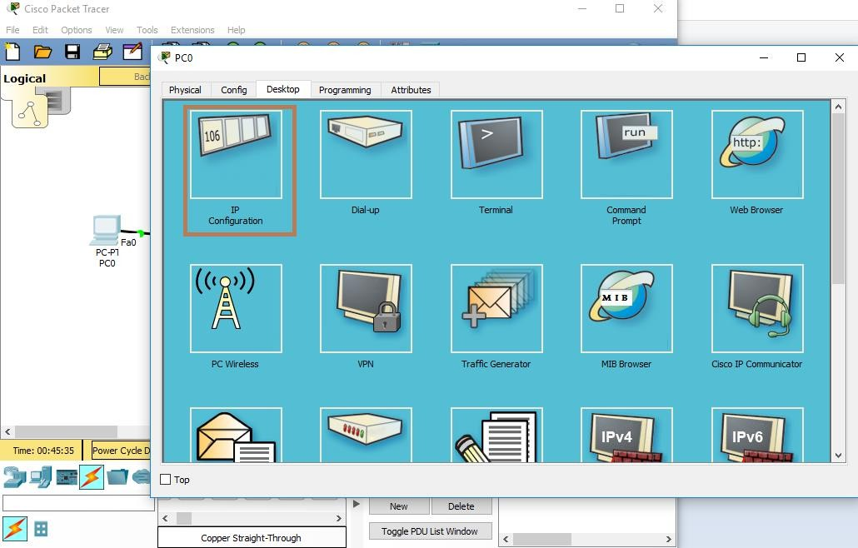
Packet Tracer
Then comes, PC configuration. To establish a network in a topology, you must provide ip addresses To the PCs and all other devices .
Click onto a pc and select ip
configuration.

Slide 16
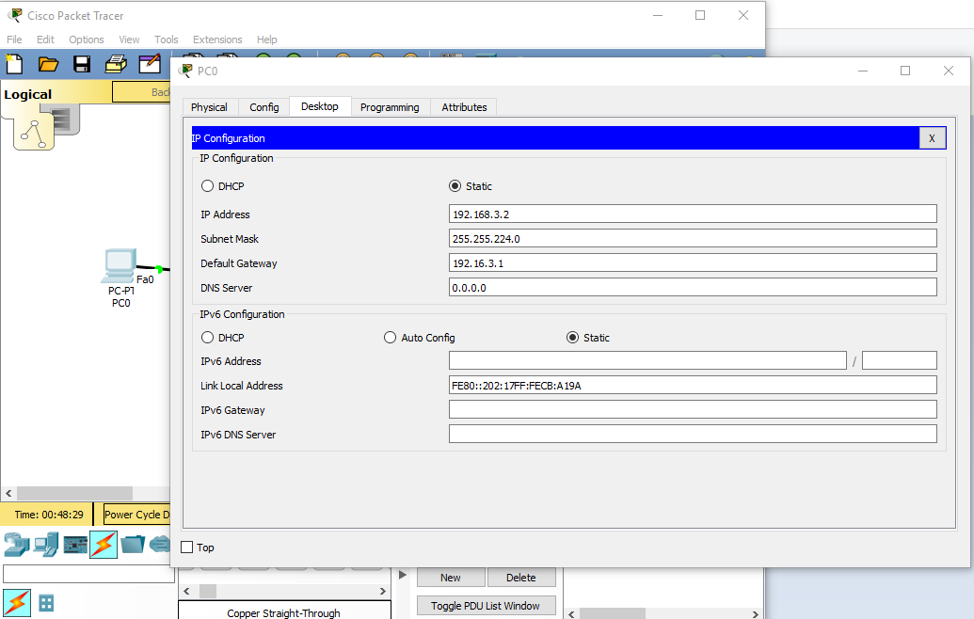
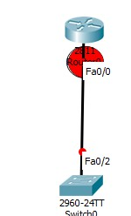
Packet Tracer
Select Desktop option.
Check if Static option is selected. It
should be Static always.
Put one of the ip addresses from your sub netted ip addresses. Fill up the subnet mask section and put an ip address for gateway.
Here the Red Marked Area is Called Gateway.

Slide 17
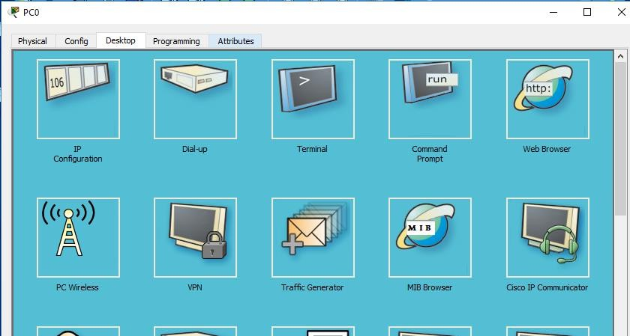
Packet Tracer
After configuring all the PCs ,you can check if the connection has been established successfully .
Click on one pc and select Command Prompt(4th option)

Slide 18
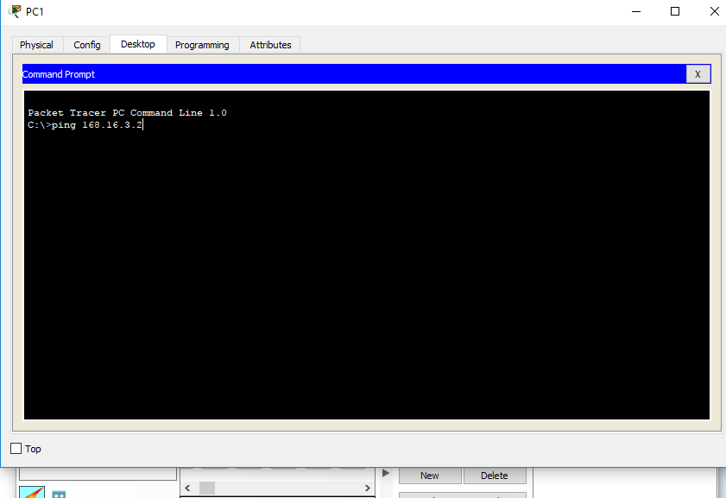
Packet Tracer
After opening up the command prompt, you will get to see a black screen .
Write there ,
ping 192.168.3.3 (2nd pc’s ip address)
Warning : Don’t give ip address of the same pc you are on or gateway ip address. It must be another pc’s ip address.

Slide 19
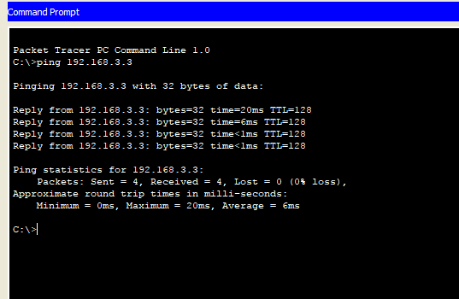
Packet Tracer
If the connection setup is successful then there will be some results showing successfully sent packets of informations.

